Slide 1
Stem Cells
Year 11 Biology
Bremer SHS

Slide 2
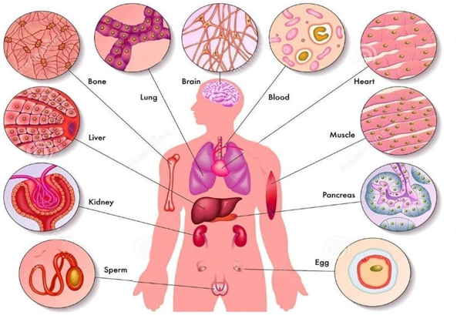
Anticipatory set
Humans have many different types of cells.
How many can you name?

Slide 3
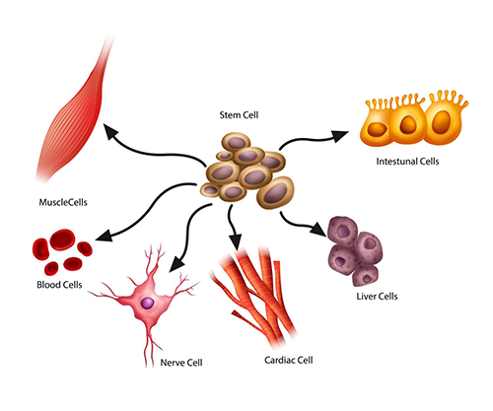
Properties of stem cells
All cells originate from a zygote, the first cell formed from the fusion of the egg and sperm of two parents.
Cells that can change or differentiate in to specialised types of cells are called stem cells.
Stem cells are capable of self-renewal.
Stem cells are categorised and named according to their potential to differentiate.
Totipotent
Pluripotent
Multipotent

Slide 4

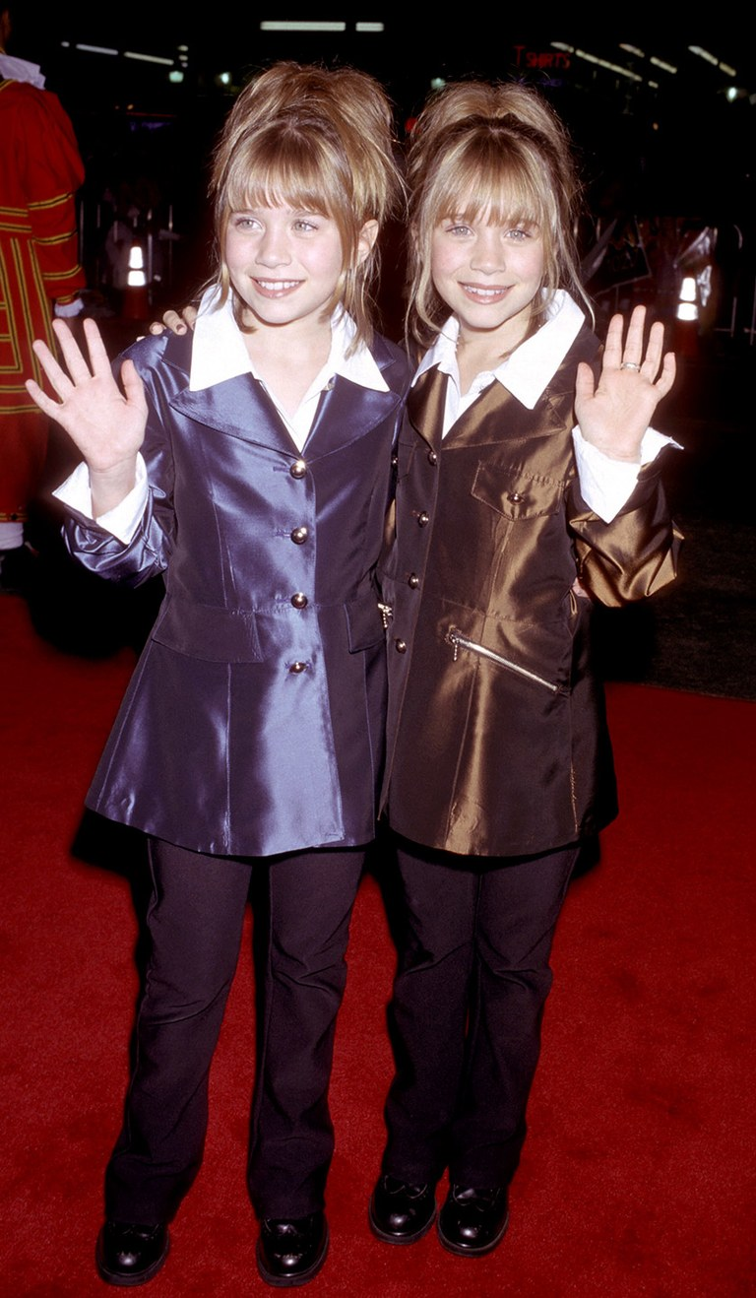
Totipotent stem cells
Totipotent stem cells have the ability to develop in to any type of cell necessary for embryonic development.
A fertilised egg (zygote) is an example of a totipotent stem cell.
A zygote divides to form two identical totipotent cells, which divide in to four then eight.
Identical twins are formed when a small cluster of totipotent cells separates.

Slide 5
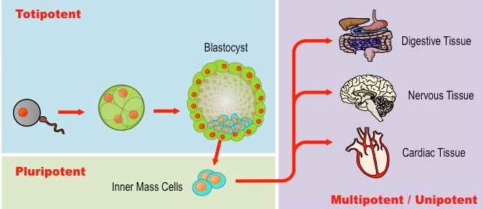
Pluripotent stem cells
Totipotent cells start to specialise to become pluripotent cells after ~5 days after fertilisation.
Cluster of cells that was once the zygote form a ball called a blastocyst
The outer layer becomes the placenta that nourishes the embryo during development.
The inner cell mass of pluripotent cells develops in to the embryo.

Slide 6
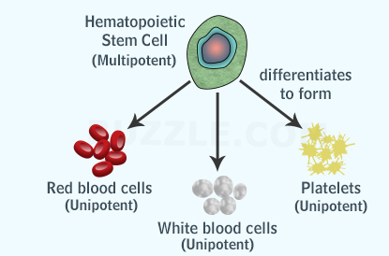
Multipotent stem cells
Each pluripotent cells undergoes further specialisation in to multipotent cells.
Multipotent cells exist in adult and embryos.
Multipotent stem cells give rise to cells that have a particular function
Eg. multipotent blood cells differentiate in to red blood cells, white blood cells and platelets.
Adult stem cells repair and replenish cells that have short life span
Eg. blood, skin and intestinal lining

Slide 7
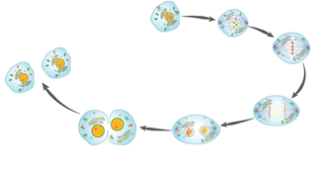
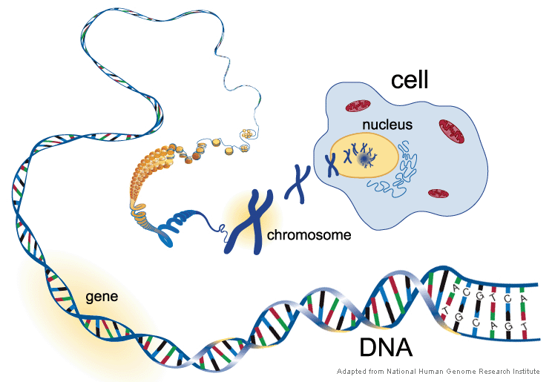
Stem cell differentiation
Cell division (mitosis) results in copies of cells that are genetically identical.
Therefore all cells within a multicellular organism are genetically identical but do not look the same or perform similar functions.
Not all genetic information is used within each type of cell, only a small portion is ‘switched on’.
The cell’s location in the developing organism and its immediate environment determine which genetic information will be ‘switched on’.
The activation of specific genetic information determines cell function.

Slide 8
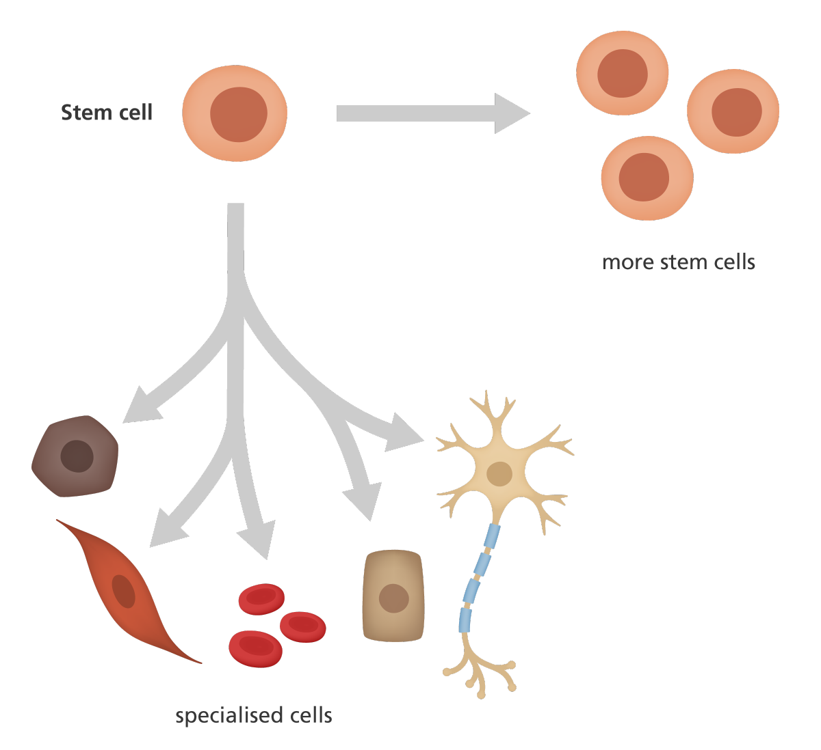
Check for understanding
Define the term cellular differentiation.
Consider the different types of stem cells. Explain how their names fit their potency.
Draw a diagram to show how totipotent stem cells can produce identical twins.
Explain why self-renewal is an important property of stem cells.
Explain how different cells arise from the same genetic code.

